Slide 1
Partitioning Algorithms: Basic Concept
Partitioning method: Partitioning a database D of n objects into a set of k clusters, such that the sum of squared distances is minimized (where c_{i} is the centroid or medoid of cluster C_{i})
Given k, find a partition of k clusters that optimizes the chosen partitioning criterion
Global optimal: exhaustively enumerate all partitions
Heuristic methods: k-means and k-medoids algorithms
k-means (MacQueen’67, Lloyd’57/’82): Each cluster is represented by the center of the cluster
k-medoids or PAM (Partition around medoids) (Kaufman & Rousseeuw’87): Each cluster is represented by one of the objects in the cluster

Slide 2
The K-Means Clustering Method
Given k, the k-means algorithm is implemented in four steps:
Partition objects into k nonempty subsets
Compute seed points as the centroids of the clusters of the current partitioning (the centroid is the center, i.e., mean point, of the cluster)
Assign each object to the cluster with the nearest seed point
Go back to Step 2, stop when the assignment does not change

Slide 3
An Example of K-Means Clustering
K=2
Arbitrarily partition objects into k groups
Update the cluster centroids
The initial data set
Loop if needed
Reassign objects
Partition objects into k nonempty subsets
Repeat
Compute centroid (i.e., mean point) for each partition
Assign each object to the cluster of its nearest centroid
Until no change
Update the cluster centroids

Slide 4
Comments on the K-Means Method
Strength: Efficient: O(tkn), where n is # objects, k is # clusters, and t is # iterations. Normally, k, t << n.
Comparing: PAM: O(k(n-k)² ), CLARA: O(ks² + k(n-k))
Comment: Often terminates at a local optimal.
Weakness
Applicable only to objects in a continuous n-dimensional space
Using the k-modes method for categorical data
In comparison, k-medoids can be applied to a wide range of data
Need to specify k, the number of clusters, in advance (there are ways to automatically determine the best k (see Hastie et al., 2009)
Sensitive to noisy data and outliers
Not suitable to discover clusters with non-convex shapes

Slide 5
k-means method is not guaranteed to converge to the global optimum and often terminates at a local optimum. To obtain good results in practice, it is common to run the k-means algorithm multiple times with different initial cluster centers.
“How can we make the k-means algorithm more scalable?”
i. use a good-sized set of samples in clustering.
ii. employ a filtering approach that uses a spatial hierarchical data index to save costs when computing means.
iii. explore the microclustering idea, which first groups nearby objects into “microclusters” and then performs k-means clustering on the microclusters.

Slide 6
Variations of the K-Means Method
Most of the variants of the k-means which differ in
Selection of the initial k means
Dissimilarity calculations
Strategies to calculate cluster means
Handling categorical data: k-modes
Replacing means of clusters with modes
Using new dissimilarity measures to deal with categorical objects
Using a frequency-based method to update modes of clusters
A mixture of categorical and numerical data: k-prototype method

Slide 7
What Is the Problem of the K-Means Method?
The k-means algorithm is sensitive to outliers !
Since an object with an extremely large value may substantially distort the distribution of the data
K-Medoids: Instead of taking the mean value of the object in a cluster as a reference point, medoids can be used, which is the most centrally located object in a cluster
10
10
9
9
8
8
7
7
6
6
5
5
4
4
3
3
2
2
1
1
0
0
1
2
3
4
5
6
7
8
9
10
0
0
1
2
3
4
5
6
7
8
9
10

Slide 8
PAM(Partitioning Around Medoids ): A Typical K-Medoids Algorithm
Total Cost = 20
10
9
8
Arbitrary choose k object as initial medoids
Assign each remaining object to nearest medoids
7
6
5
4
3
2
1
0
0
1
2
3
4
5
6
7
8
9
10
K=2
Randomly select a nonmedoid object,O_{ramdom}
Total Cost = 26
Do loop
Until no change
10
10
9
Compute total cost of swapping
9
Swapping O and O_{ramdom}
If quality is improved.
8
8
7
7
6
6
5
5
4
4
3
3
2
2
1
1
0
0
1
2
3
4
5
6
7
8
9
10
0
0
1
2
3
4
5
6
7
8
9
10
8
Notes:
8

Slide 9
K-Medoids clustering

Slide 10
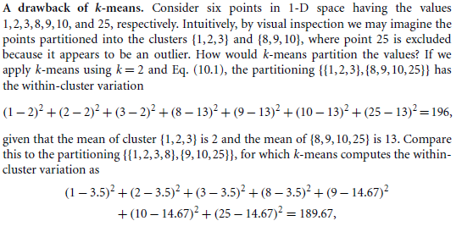


Slide 11

K-Medoids clustering
The dissimilarity of the medoid(Ci) and object(Pi) is calculated by using E = |Pi - Ci|
The cost in K-Medoids algorithm is given as

Slide 12
Algorithm
Initialize: select k random points out of the n data points as the medoids.
Associate each data point to the closest medoid by using any common distance metric methods.
While the cost decreases: For each medoid m, for each data o point which is not a medoid: 1. Swap m and o, associate each data point to the closest medoid, recompute the cost. 2. If the total cost is more than that in the previous step, undo the swap.

Slide 13
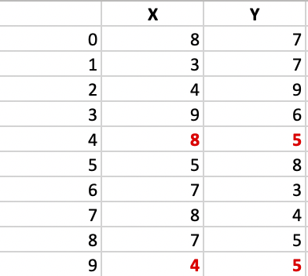
Example:

Slide 14
Step 1: Let the randomly selected 2 medoids, so select k = 2 and let C1 -(4, 5) and C2 -(8, 5) are the two medoids.

Slide 15
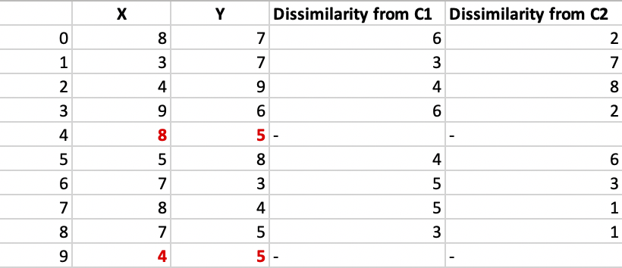
Step 2: Calculating cost. The dissimilarity of each non-medoid point with the medoids is calculated and tabulated

Slide 16
Each point is assigned to the cluster of that medoid whose dissimilarity is less. The points 1, 2, 5 go to cluster C1 and 0, 3, 6, 7, 8 go to cluster C2. The Cost = (3 + 4 + 4) + (3 + 1 + 1 + 2 + 2) = 20

Slide 17
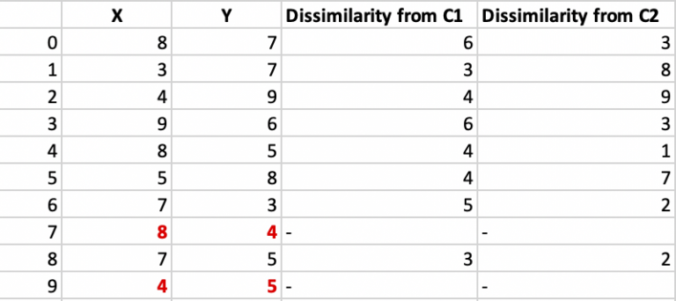
Step 3: randomly select one non-medoid point and recalculate the cost. Let the randomly selected point be (8, 4). The dissimilarity of each non-medoid point with the medoids – C1 (4, 5) and C2 (8, 4) is calculated and tabulated.

Slide 18
Each point is assigned to that cluster whose dissimilarity is less. So, the points 1, 2, 5 go to cluster C1 and 0, 3, 6, 7, 8 go to cluster C2.
The New cost = (3 + 4 + 4) + (2 + 2 + 1 + 3 + 3) = 22 Swap Cost = New Cost – Previous Cost = 22 – 20 and 2 >0
As the swap cost is not less than zero, we undo the swap. Hence C1 -(4, 5) and C2 -(8, 5) are the final medoids.

Slide 19
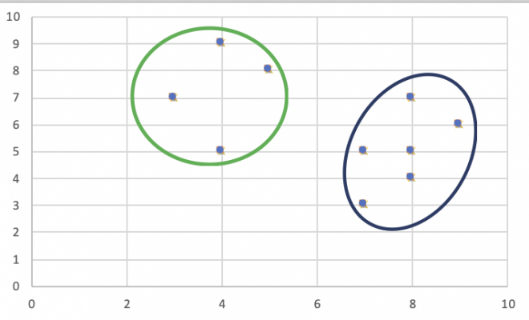
The clustering would be in the following way
The time complexity is

Slide 20
Advantages:
It is simple to understand and easy to implement.
K-Medoid Algorithm is fast and converges in a fixed number of steps.
PAM is less sensitive to outliers than other partitioning algorithms.
Disadvantages:
The main disadvantage of K-Medoid algorithms is that it is not suitable for clustering non-spherical (arbitrary shaped) groups of objects. This is because it relies on minimizing the distances between the non-medoid objects and the medoid (the cluster centre) – briefly, it uses compactness as clustering criteria instead of connectivity.
It may obtain different results for different runs on the same dataset because the first k medoids are chosen randomly.

Slide 21
The K-Medoid Clustering Method
K-Medoids Clustering: Find representative objects (medoids) in clusters
PAM (Partitioning Around Medoids, Kaufmann & Rousseeuw 1987)
Starts from an initial set of medoids and iteratively replaces one of the medoids by one of the non-medoids if it improves the total distance of the resulting clustering
PAM works effectively for small data sets, but does not scale well for large data sets (due to the computational complexity)
Efficiency improvement on PAM
CLARA (Kaufmann & Rousseeuw, 1990): PAM on samples
CLARANS (Ng & Han, 1994): Randomized re-sampling

Slide 22
“How can we scale up the k-medoids method?”
k-medoids partitioning algorithm like works effectively for small data sets, but does not scale well for large data sets.
To deal with larger data sets, a sampling-based method called CLARA (Clustering LARge Applications) can be used. Instead of taking the whole data set into consideration, CLARA uses a random sample of the data set. The PAM algorithm is then applied to compute the best medoids from the sample.
The complexity of computing the medoids on a random sample is
where s is the size of the sample, k is the number of clusters, and n is the total number of objects. CLARA can deal with larger data sets than PAM.

Slide 23
“How might we improve the quality and scalability of CLARA?”
PAM examines every object in the data set against every current medoid, whereas CLARA confines the candidate medoids to only a random sample of the data set.
A randomized algorithm called CLARANS (Clustering Large Applications based upon RANdomized Search) presents a trade-off between the cost and the effectiveness of using samples to obtain clustering.

Slide 24
CLARANS
First, it randomly selects k objects in the data set as the current medoids.
It then randomly selects a current medoid x and an object y that is not one of the current medoids.
Can replacing x by y improve the absolute-error criterion? If yes, the replacement is made. CLARANS conducts such a randomized search l times.
The set of the current medoids after the l steps is considered a local optimum. CLARANS repeats this randomized process m times and returns the best local optimal as the final result.

Slide 25
How to determine the optimal number of clusters for k-means clustering
For each k value, we will initialise k-means and use the inertia attribute to identify the sum of squared distances of samples to the nearest cluster centre.

Slide 26
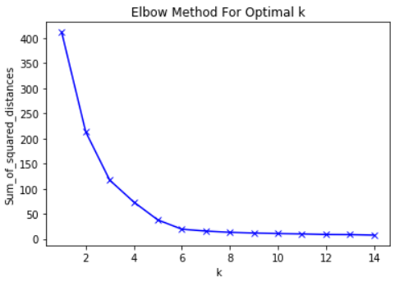
Below is a plot of sum of squared distances for k in the range specified above. If the plot looks like an arm, then the elbow on the arm is optimal k.
In the plot above the elbow is at k=5 indicating the optimal k for this dataset is 5

Slide 27
References
Jiawei Han and Micheline Kamber, Jian Pei, “Data Mining: Concepts and Techniques”, Third Edition, Elsevier, 2012. (chapter 10)
geeksforgeeks.org/ml-k-medoids-clustering-with-example/
https://blog.cambridgespark.com/how-to-determine-the-optimal-number-of-clusters-for-k-means-clustering-14f27070048f

Slide 28


